Slide 1
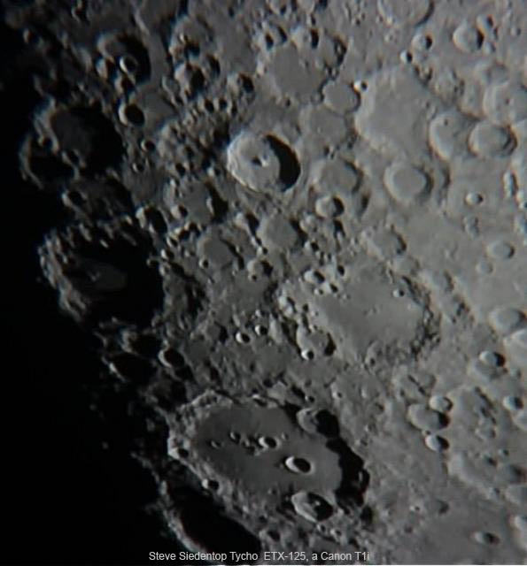

Slide 2
“What’s up”
A presentation of “what’s up” in the night sky

Slide 3
This Month’s Sky: September2012
Our Solar System Tonight
This Month’s Astro Events
Target List
Gee Whiz Question of the Month
CE Observing Challenge

Slide 4
Our Solar System Tonight
 | Rises | Sets
Sun | 7:08 A.M. | 5:31 P.M.
Moon | 10:52 A.M. | 9:40 P.M.
Mercury | 7:11 A.M. | 5:29 P.M.
Venus | 4:38 A.M. | 4:02 P.M.
Mars | 9:56 A.M. | 7:41 P.M.
Jupiter | 6:29 P.M. | 8:29 A.M.
Saturn | 5:29 A.M. | 4:33 P.M
Uranus | 2:59 P.M. | 3:13 A.M
Neptune | 1:26 P.M. | 12:29 A.M.
Pluto | 10:12 A.M. | 8:26 P.M

Slide 5
This Month’s Astro Events
Jupiter is reaching its peak
Leonid Meteor Shower
Lonely Fomalhaut
Heads up for December

Slide 6
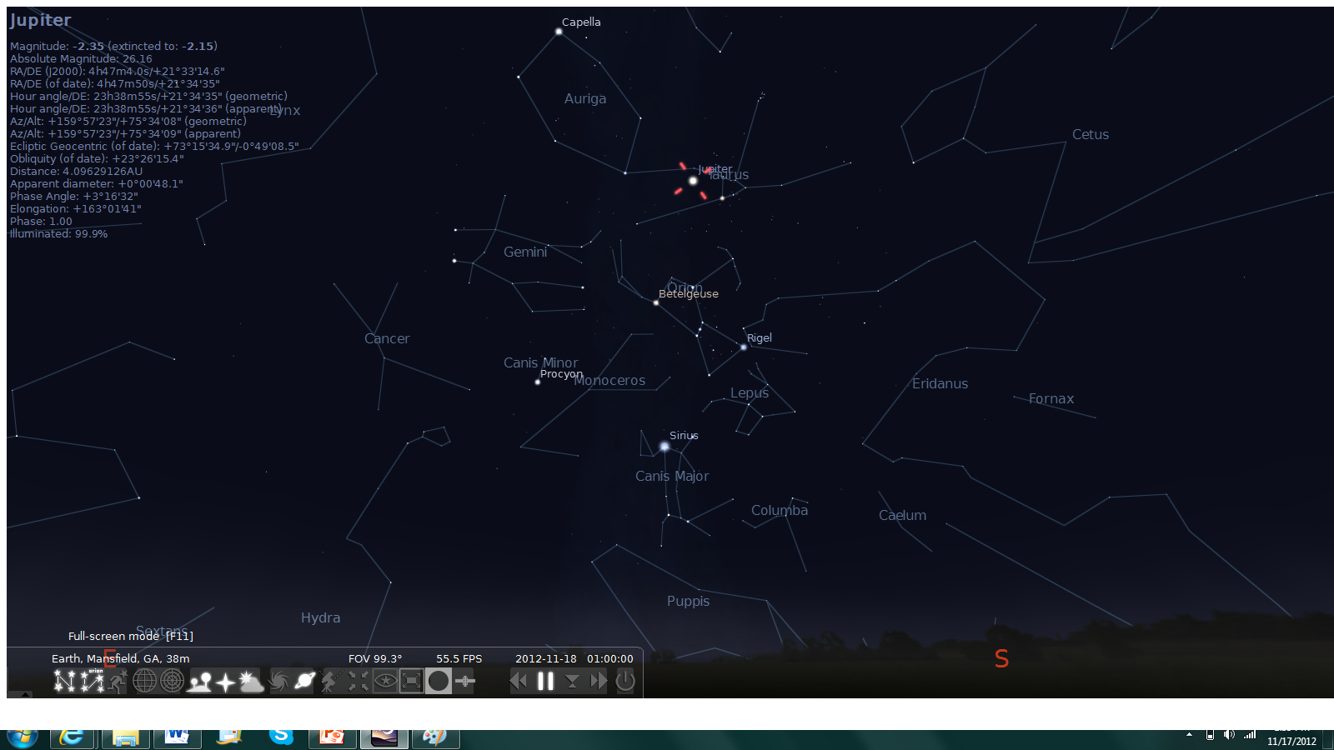
Jupiter: King of the Sky

Slide 7
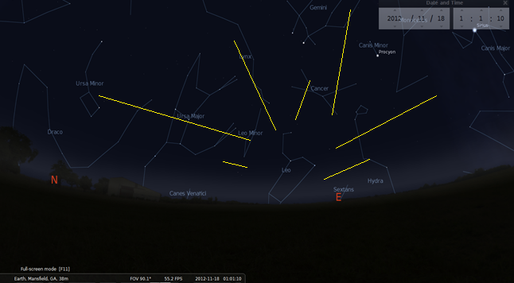
Leonids Meteor Shower
Peak: Nov. 17th; Max 10-15/Hour

Slide 8
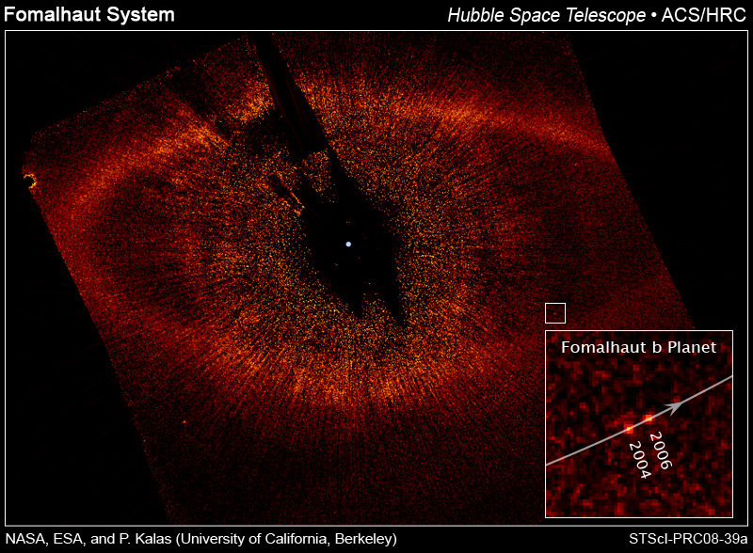
Fomalhault
Not lonely any more!

Slide 9
Target List
Object | Type | Mag | Constellation
M92 | Globular Cluster | 6.4 | Hercules
M42 | Nebula
NGC 6960 (W. Veil) | Nebula | 5 | Cygnus
NGC 6995 (E. Veil) | Nebula | 5 | Cygnus
Sigma Orionis | Double Star | 3.8/6.7 | Orion
NGC 2261 | Nebula | 9.2 | Monoceros
M81 & M82 | Spiral/Galaxy | 7/8.4 | Ursa Major
M36 | Open Cluster | 6 | Auriga
NGC 869 | Open Cluster | 5.3 | Perseus

Slide 10
Gee Whiz Question of the Month
Approximately what percent of matter in the universe is “Visible Matter”? What is the rest called?

Slide 11
Gee Whiz Question of the Month
5%. Dark Matter

Slide 12
CE Observing Challenge
NCG 7008
Magnitude 13 (extremely difficult)
Between Cepheus and Cygnus
R.A: 21h 0m 59s
Dec: 54° 36’ 03”
ENJOY!!!

Slide 13
Useful Websites
http://www.almanac.com/astronomy/
http://astrojourney.wordpress.com
http://www.astronomy.com/

